Slide 1

UAE SME Growth Dashboard
Objective of the project: Analyzing SME Performance & predict growth
Tools Used : Python, Power BI, SQL, Machine Learning
Presented By : Sandra Raj P

Slide 2
Project description
The UAE SME Analytics project is designed to provide a comprehensive, AI-powered analysis of Small and Medium Enterprises (SMEs) in the UAE. Using Machine Learning algorithms, historical SME data is analyzed to predict revenue, profit trends, and growth opportunities, while identifying patterns and anomalies in performance across sectors.
The project integrates data cleaning, exploratory data analysis (EDA), and predictive modeling to generate actionable insights for business owners, investors, and policymakers. Interactive dashboards built with Power BI visualize key metrics such as revenue, profit margins, sector performance, and the impact of government policies, supporting data-driven decision-making and tracking progress towards UAE Vision 2030 SME targets.
In this project we are required to clean the data, find the total calls by all the agents, Average satisfaction score, Average response time, Number of topics, the most calls by the topic, Sum of resolved by topic, and speed of response and visualize them in charts.

Slide 3
overview
SMEs are the backbones of UAE’s economy
Key metrics tracked:
Total Revenue, Average Order Value, Churn Rate, New Customers
Track Revenue Growth Over Time
Monitor Churn Rate & Customer Retention
Compare Marketing Spend vs Sales
Identify Top Performing Emirates & Industries
Support Data-driven decision making

Slide 4
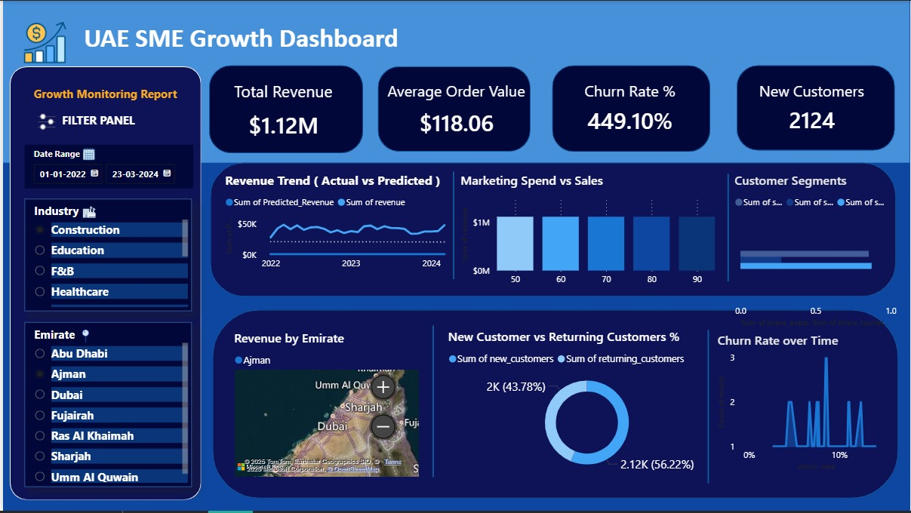
Dashboard
Data Driven Insights for Small Medium Enterprises

Slide 5
Data & Methodology
Data Sources : SME financial & Customer Data (2022-2024)
Steps:
Data Cleaning & Preprocessing (Python)
SQL Database
Feature Engineering & Forecasting (Linear Regression/Random Forest)
Dashboard Creation (Power BI)

Slide 6
Dashboard Features
KPI Cards: Revenue, Avg Order Value, Churn, New Customers Interactive
Filters: Date, Industry, Emirate
Charts :
Revenue Trend (Actual vs Predicted), Marketing Spend vs Sales ,
Customer Segments ,Revenue by Emirate (Map),
New vs Returning Customers , Churn Rate over Time

Slide 7
INSIGHTS
Total Revenue: $1.12M
Avg Order Value: $118
Churn Rate: 449% (high, needs retention strategies)
New Customers: 2124
Dubai & Abu Dhabi drive most revenue
Returning customers contribute 56% revenue

Slide 8
RECOMMENDATIONS
Invest more in customer retention strategies.
Optimize marketing spend for better ROI.
Expand in high-performing Emirates (Dubai, Abu Dhabi).
Support SMEs in sectors like Construction & Education.

Slide 9
CONCLUSION
Dashboard provides real-time SME monitoring
Helps stakeholders make data-driven decisions
Supports UAE’s Vision 2030 for SME growth

Slide 10
Thank YOU
Email –sandraraj36@gmail.com LinkedIn – www.linkedin.com/in/sandrarajp Github - https://github.com/sandrarajp

